Slide 1
Artificial Intelligence, Machine Learning and Microsoft Cognitive Services

Slide 2
“Artificial Intelligence is just whatever a computer can’t do yet…”
Chris Bishop, Microsoft Research
Notes:
Chris is probably somewhere in the building today. In fact, is he here?
The continuing moving of the goal post.

Slide 3
“Artificial Intelligence is computers doing things that we would normally think of as intelligent in humans.”
Rick Barazza, Microsoft DX
Notes:
Our working definition.
It’s not just doing things that humans do. That’s not very hard. Humans do all sorts of dumb things that much simpler animals do. So we’re setting the bar higher than that. But not crazy high. We’re saying, AI is about carving out more and more pieces of intelligent behavior. And so by that definition AI is here today, and has been for a while now.
Before we talk about how Artificial Intelligence works, let’s talk briefly about Natural Intelligence.

Slide 4
Does your bot need AI?
Probably not
Azure Search
Existing APIs
Button driven
Like any other feature, use them to provide better experience
Natural language processing (NLP)
Mood detection

Slide 5
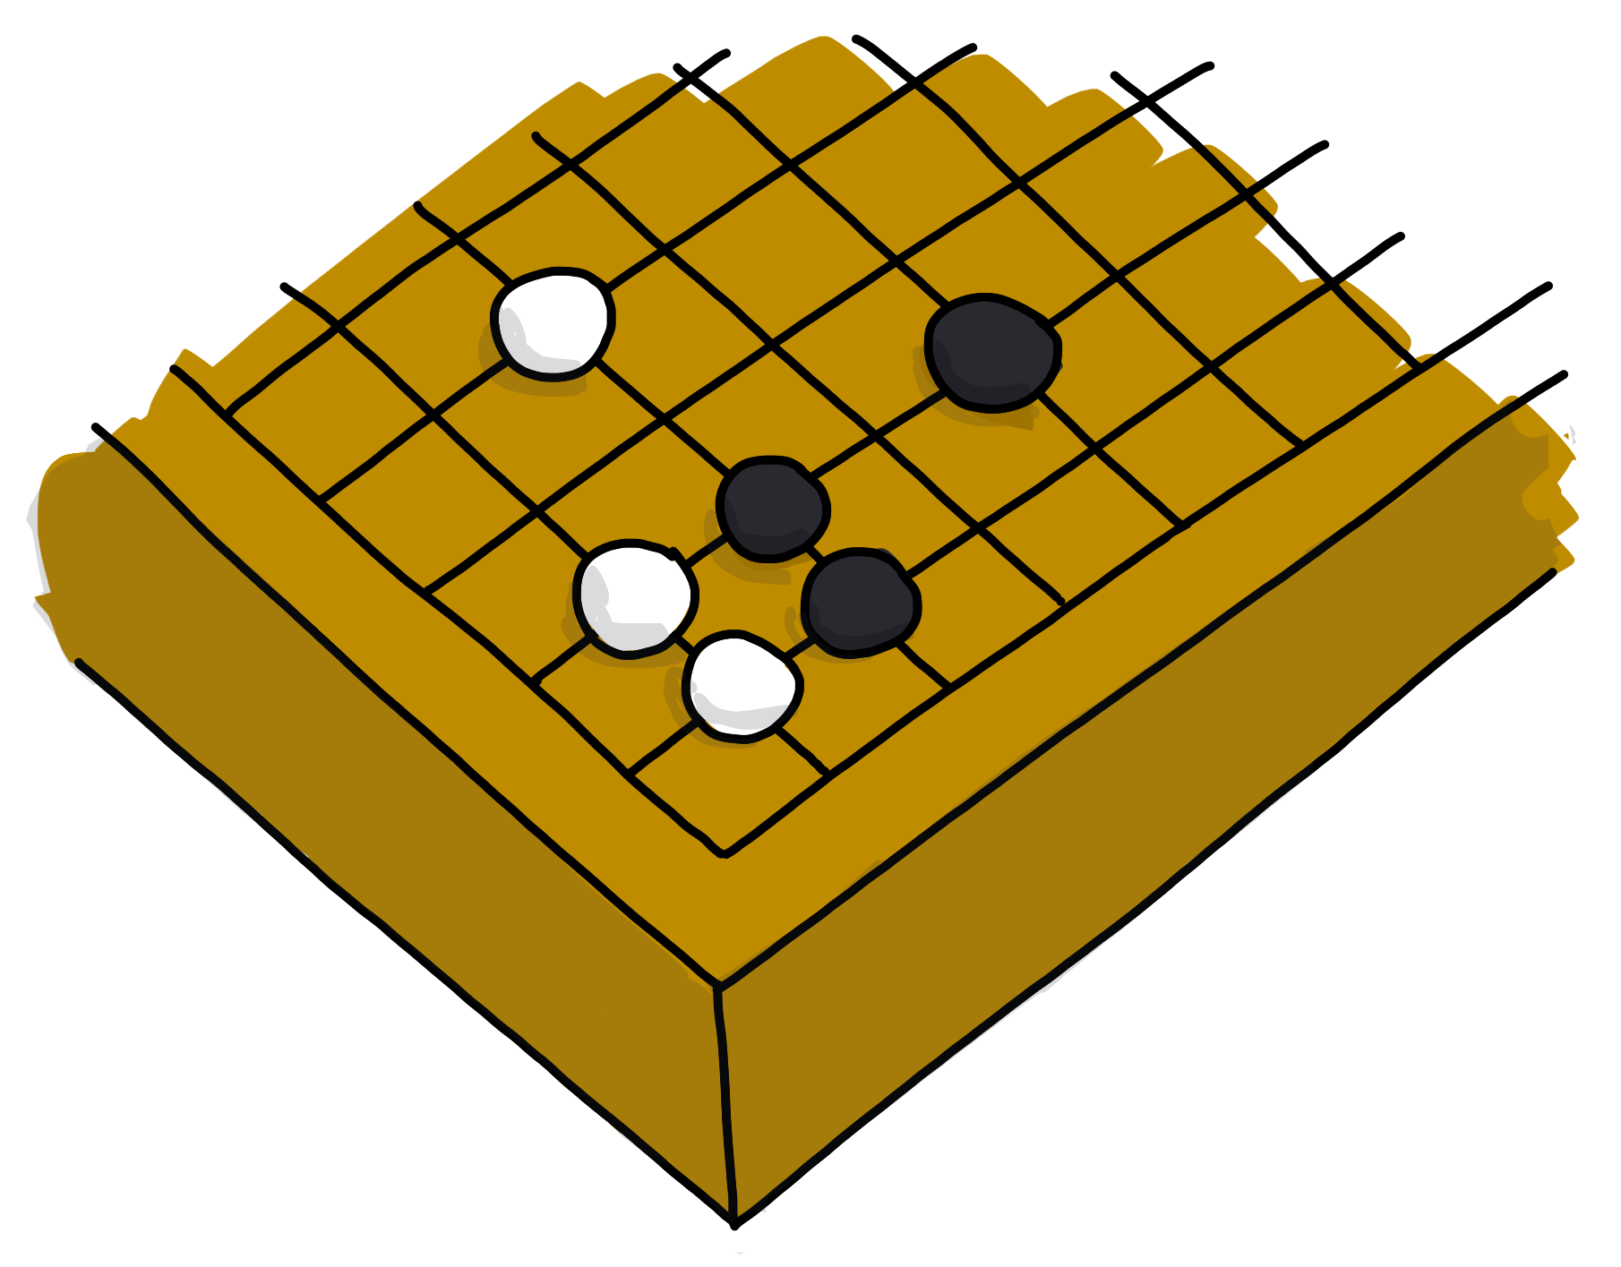
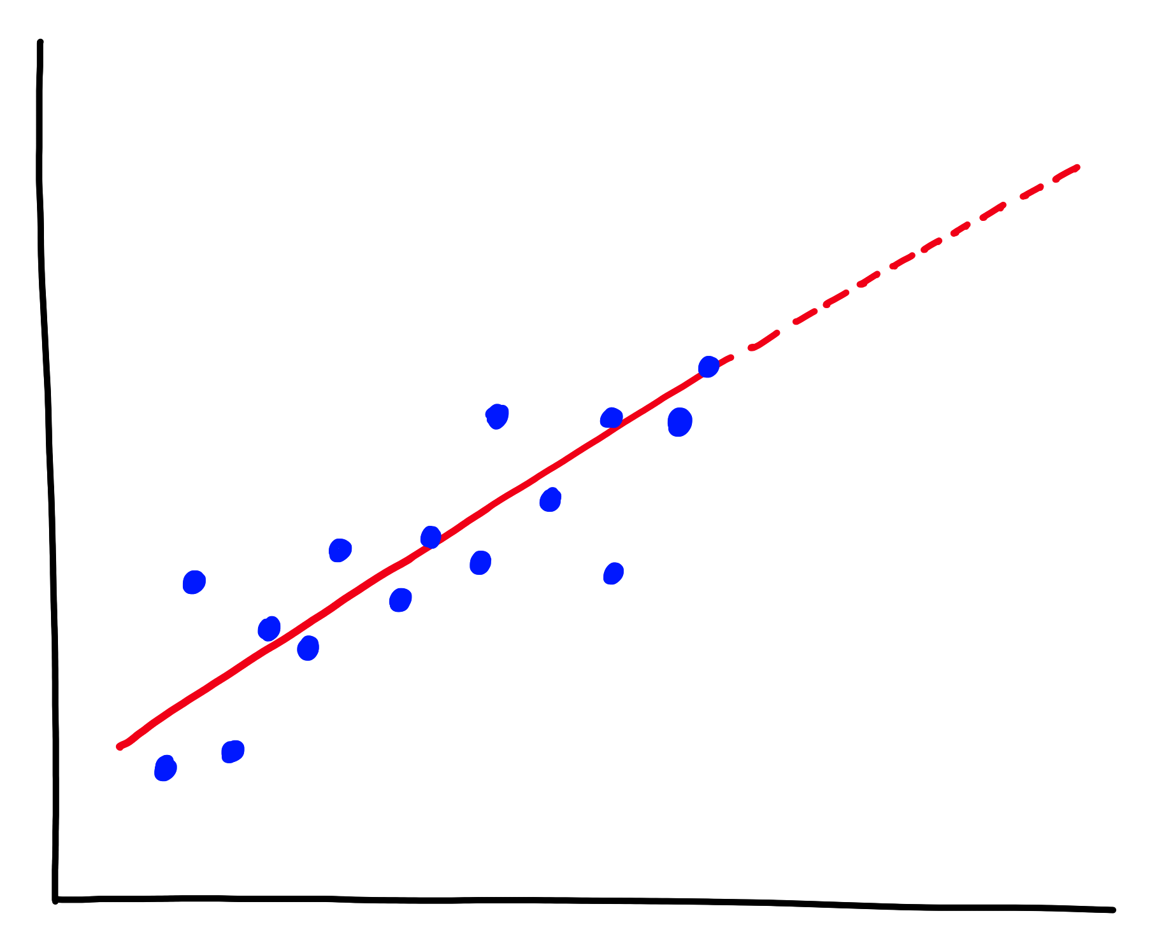
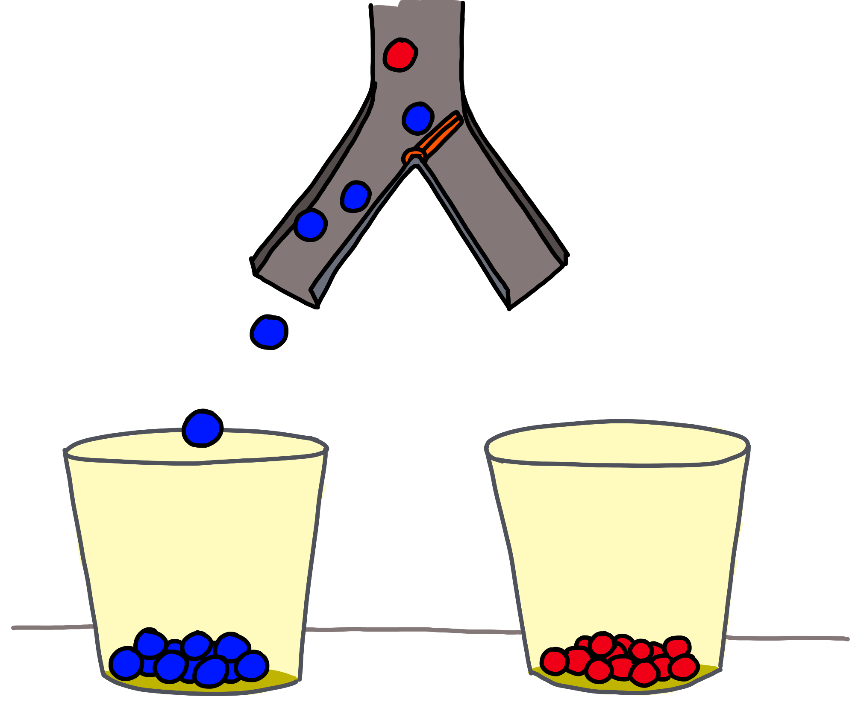
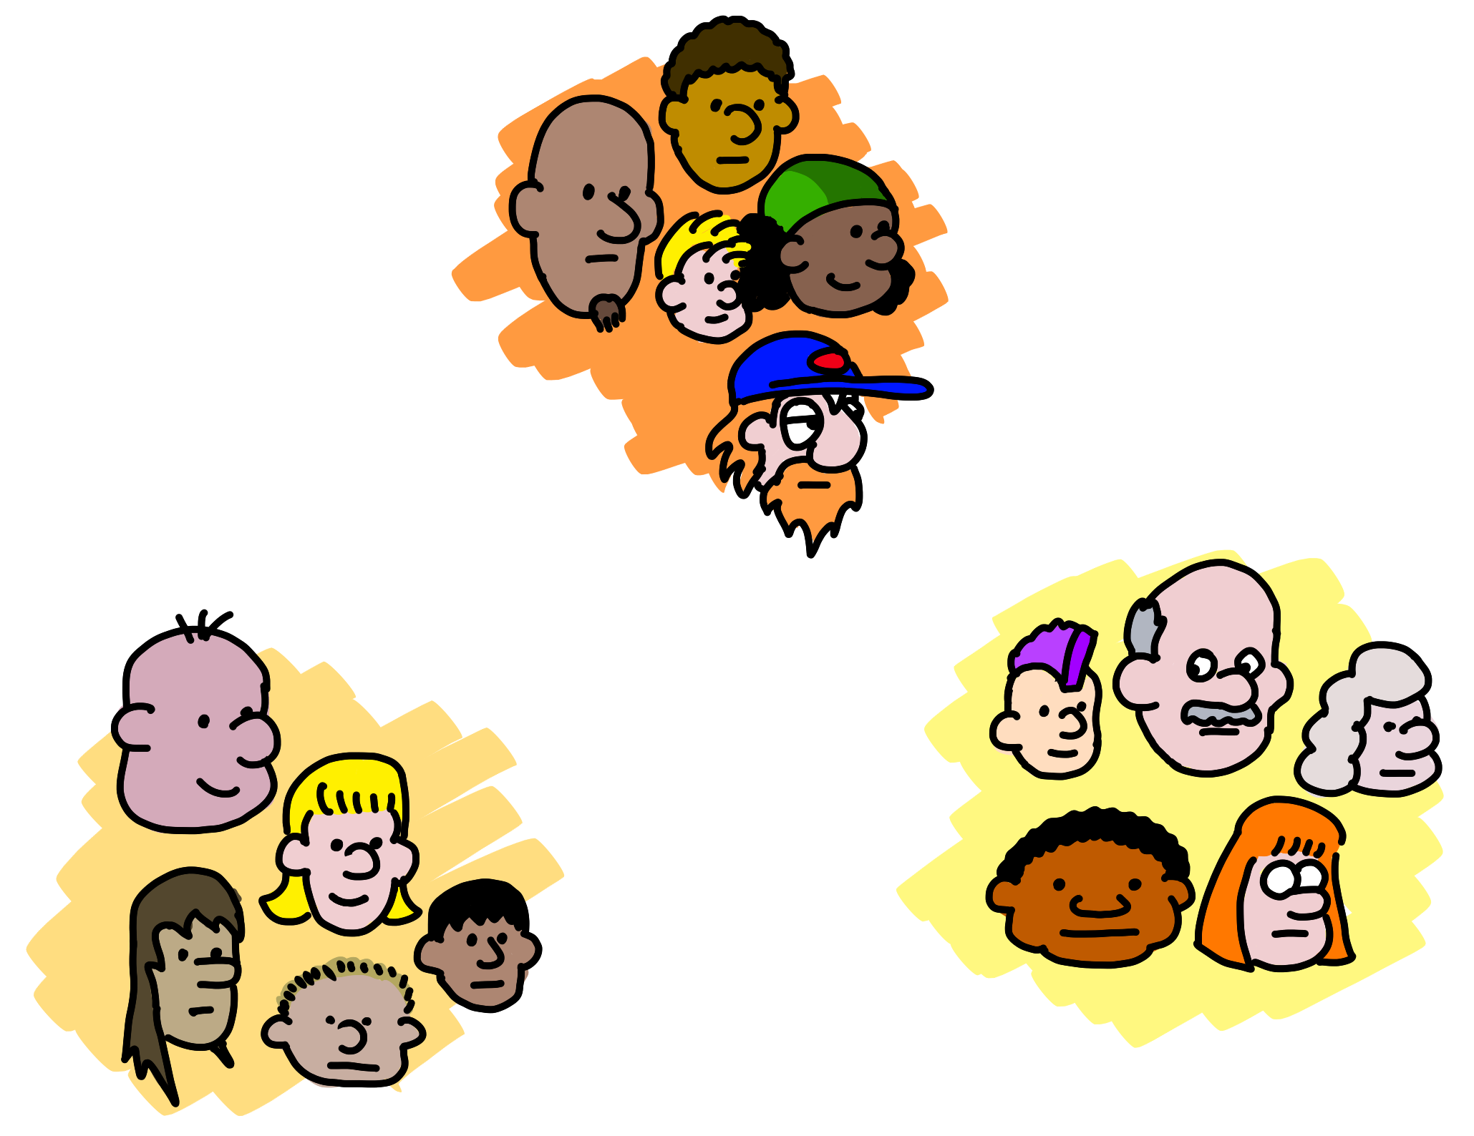
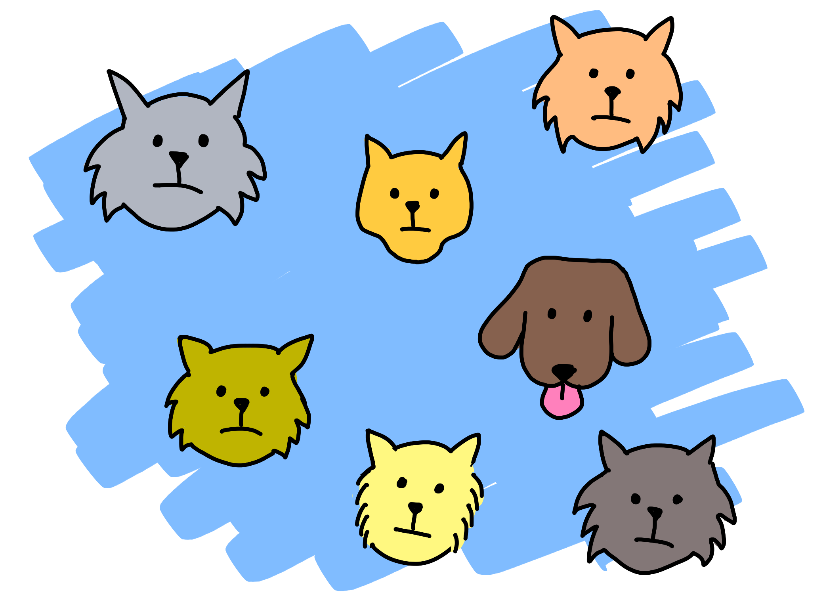
Predict how much/many
(Regression)
What next?
(Reinforcement Learning)
Which category?
(Classification)
Is it weird?
(Anomaly)
Data structure
(Clustering,
Recommender)
5 questions courtesy Brandon Rohrer
Notes:
The five questions you can answer with traditional ML
Regression: Predict a real value for new data given trends in tagged example. How much/how many? e.g. Sea level rise: we are currently using data on sea level changes over the past century and the accelerating upward trend to estimate the amount of sea level rise in the coming century.
Anomaly: Identify when something unexpected happens. – Is this weird? E.g. Pacemaker hacking: research is being done to detect malware in a pacemaker in order to prevent data hijacking or malware-related malfunctioning by using an anomaly detector to pick up changes in data transmission timing to a cardiac log or even power consumption and electromagnetic radiation changes.
Reinforcement Learning: Take some appropriate action or next step E.g. Roomba or Roomba-competitor: a Roomba decides whether to return to the base or vacuum the living room again – there’s some sort of reward/penalty involved here.
Classification: Assign a category to each item or data point E.g. Exploring the night sky for planets: light curves (stellar brightness over time) of a unexamined stars with Kepler data are being classified as either having transiting planets or not using a pre-trained model on stars with and without transiting planets.
Clustering/Recommenders: Get to the structure or layout of data. Are there clearly separable groups? E.g. Hepatocellular carcinoma metastasis: researchers are looking at the differential profiles of proteins being expressed to find those that are upregulated during the cell invasion process in order to find new cancer treatment targets.
Also questions you can’t ask. Que

Slide 6
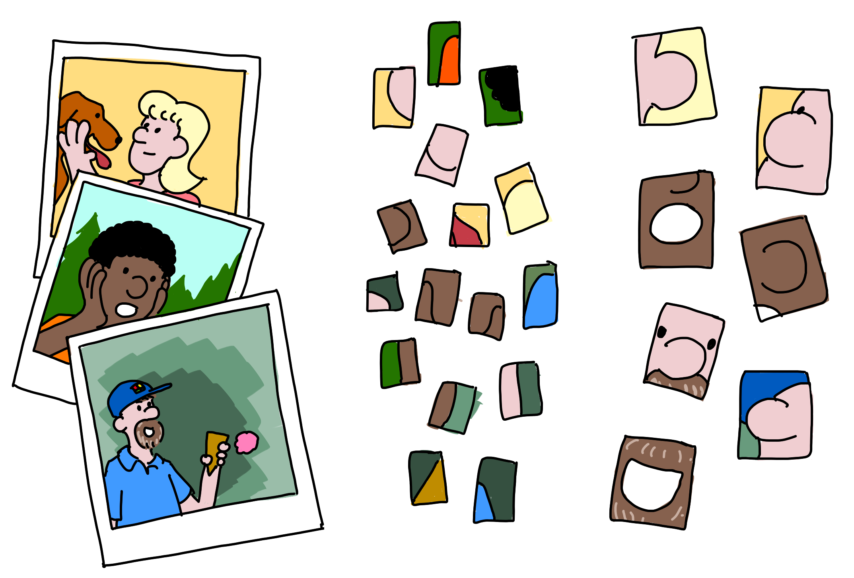
Notes:
Example
Five layers
Input layer (pictures including faces – 3 polaroids)
Edges
Nose/Ears/Eyes/Mouths
Whole Faces
“This is probably Bill”
Our sci-fi future, powered by DNN:
Composing models
Extracting style
Your choice
Main point: DNNs don’t just answer questions, allow us to create and transform

Slide 7



Easy
Why Microsoft Cognitive Services?
Flexible
Tested

Slide 8








Why Microsoft Cognitive Services?
Easy
Flexible
Tested
Roll your own with REST APIs
Integrate into the language and platform of your choice
Built by experts in their field from Microsoft Research, Bing, and Azure Machine Learning
Simple to add: just a few lines of code required
Breadth of offerings helps you find the right API for your app
Quality documentation, sample code, and community support
GET A KEY
BUILD

Slide 9

Vision
From faces to feelings, allow your apps to understand images and video
Microsoft Cognitive Services
Give your apps a human side
Speech
Hear and speak to your users by filtering noise, identifying speakers, and understanding intent
Language
Process text and learn how to recognize what users want
Knowledge
Tap into rich knowledge amassed from the web, academia, or your own data
Search
Access billions of web pages, images, videos, and news with the power of Bing APIs

Slide 10
Cognitive Services API Collection
Vision
Computer Vision | Emotion | Face | Video
Microsoft Cognitive Services
Give your apps a human side
Speech
Bing Speech | Custom Speech Service (formerly CRIS) | Speaker Recognition
Language
Bing Spell Check | Language Understanding | Linguistic Analysis | Text Analytics | Translator | Web Language Model
Knowledge
Academic Knowledge | Entity Linking | Knowledge Exploration | QnA Maker | Recommendations
Search
Bing Autosuggest | Bing Image Search | Bing Knowledge Graph | Bing News Search | Bing Video Search | Bing Web Search

Slide 11
Cognitive Services Demos

Slide 12
What did you think of the service provided today?
Everything was terrible! I hated it!!
Thank you so much for your feedback. Have a nice day!

Slide 13
Text Analytics

Slide 14
What is the user saying?
Topics?
Themes?
Language?
Mood?

Slide 15
Text Analytics
Language
Sentiment
Key phrases

Slide 16
The run across Golden Gate was gorgeous!
Key phrases:
{ "documents":
[
{
"keyPhrases":
[ "run", "Golden Gate" ],
"id": "0"
}
],
"errors": []
}
Sentiment:
{ "documents":
[
{
"score": 0.9304294,
"id": "0"
}
],
"errors": []
}

Slide 17
Text Analytics

Slide 18
Translator Hub

Slide 19
Automating translation
Many services start as English only
Cognitive Services
Certain LUIS features
Translate before sending to service
Bots are a conversational interface
Translate for globalization/localization

Slide 20
Managing translations
Text Translator API
Context unaware translations
Microsoft Translator Hub
Add context to translations
Collaborative Translation Framework (CTF)
Crowd source translations

Slide 21
Implementing automatic translations

Slide 22
Your turn
Update your bot to:
Ask the user for feedback
Reply with an appropriate message based on the feedback

